Slide 1
Rapid Power BI Development with ChatGPT
Pedro Reis

Slide 2



About the speaker
Microsoft Data Platform MVP / MCT
Expert Leader Data & AI
Leader of Fabric PBI Portugal Group
www.fabricbi.net (training / consulting)
pedroreis@reispm.onmicrosoft.com
https://www.linkedin.com/in/pedrogoncalvesreis/
www.fabricbi.net/

Slide 3
Agenda
Today’s 20m Session
DAX w/ SVG and CSS
Data Modeling & Analysis
Report Design Assessment
Troubleshooting
Knowledge Assessment and Improvement
Tomorrow’s 40m Deep Dive
Generate a Data Model
Generate Artificial Data
Generate Power Query code
Generate DAX Measures
Enhance Report Theme
Publication & Administration w/ Cmdlets
Key Takeaways / The Future

Slide 4

1) DAX with SVG and CSS
DAX with SVG
DAX with CSS on HTML visual

Slide 5
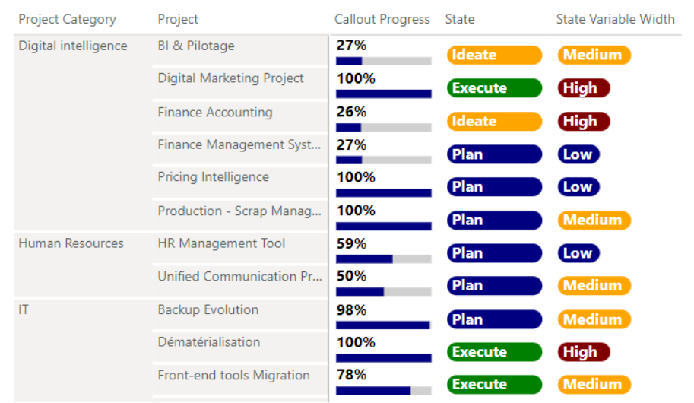
How to create something like this? Power BI Table / Matrix require full cell background formatting
Source: Progress Callout - EXPLORATIONS IN DATA STORYTELLING WITH POWER BI (kerrykolosko.com)

Slide 6
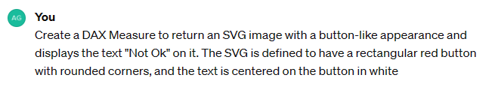
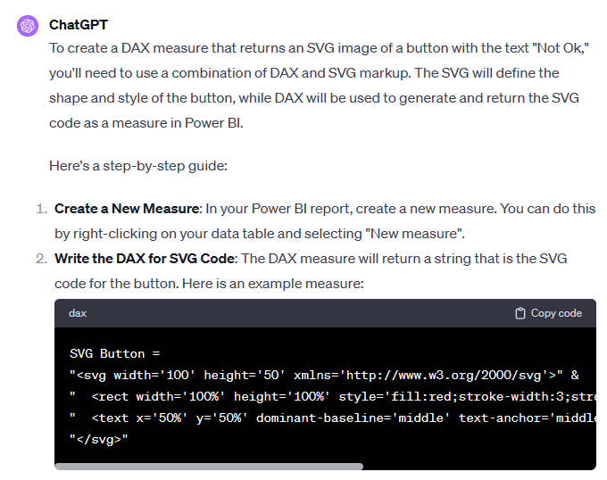
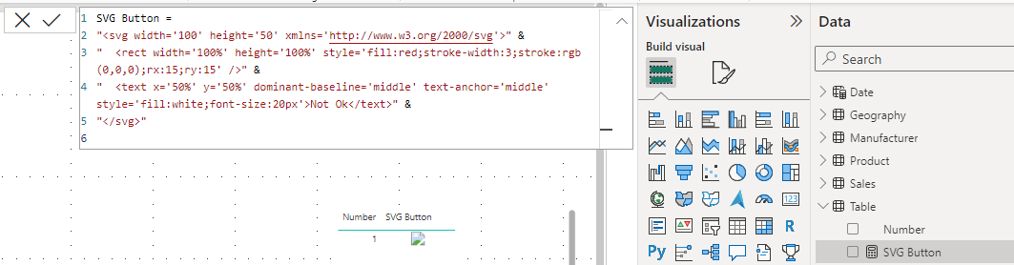
Generate DAX Measure with SVG

Slide 7
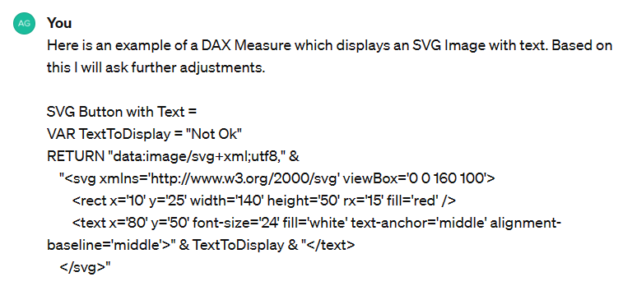
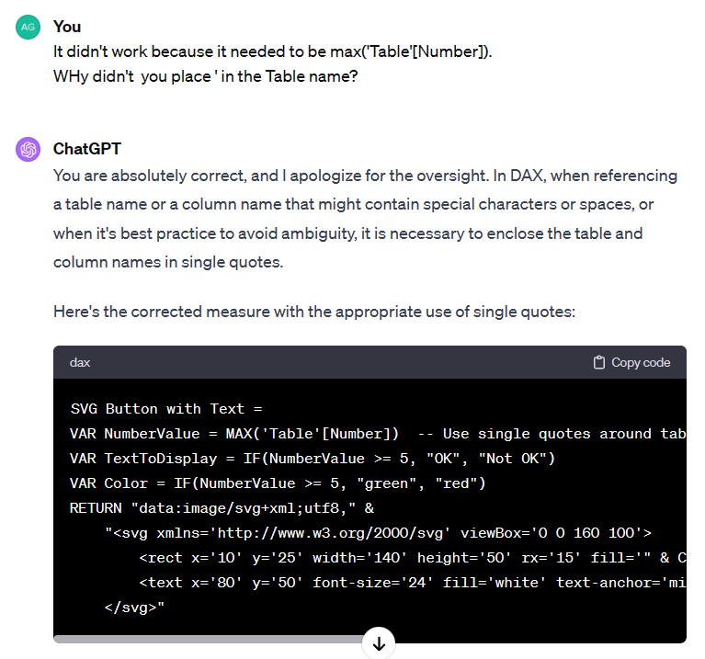
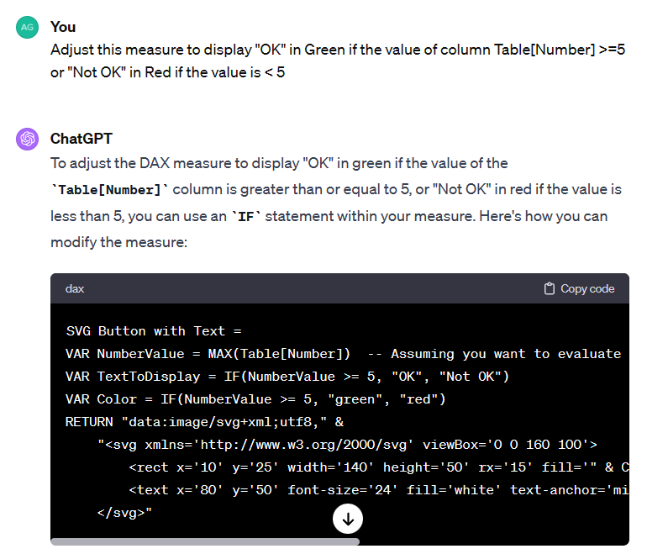
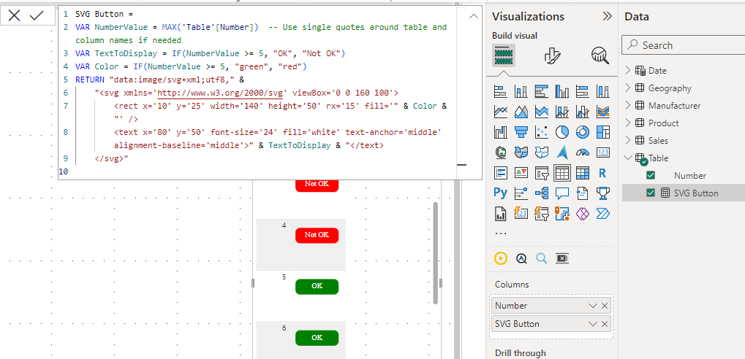

Generate DAX Measure with SVG

Slide 8
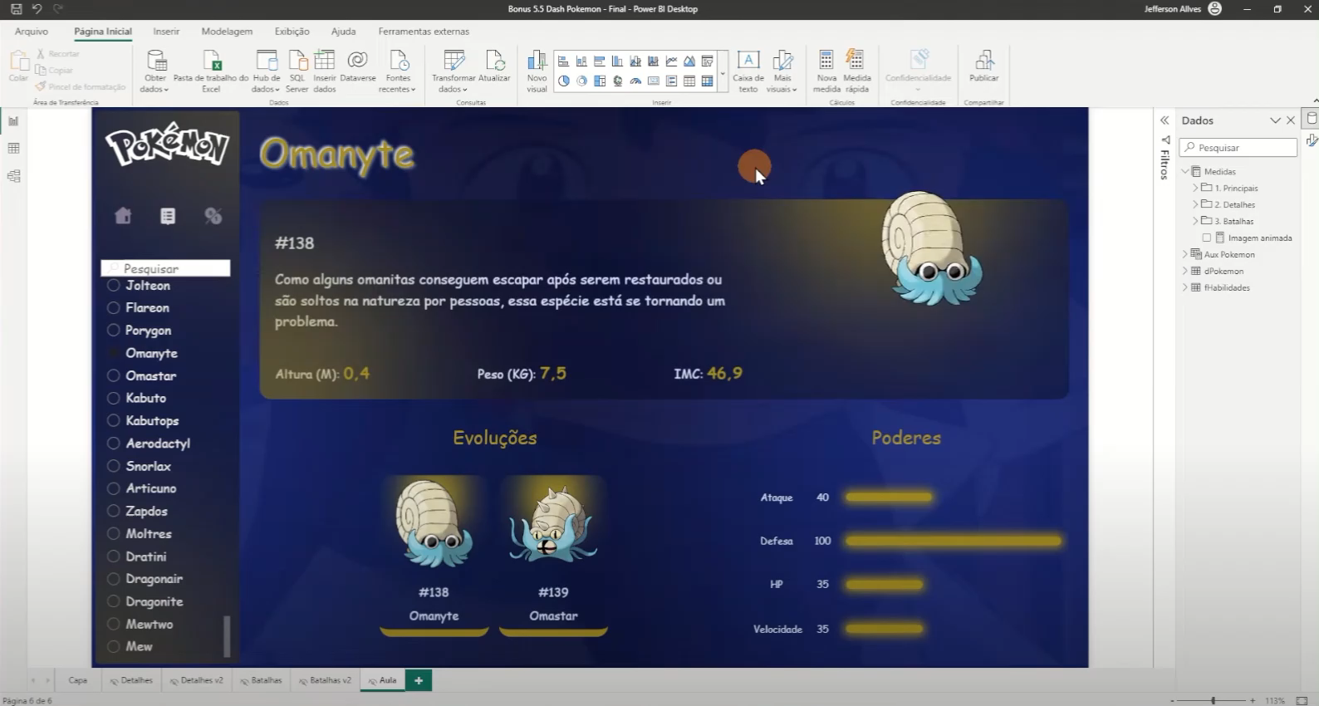
Source: Jefferson Alves – Dados Criativos

Slide 9
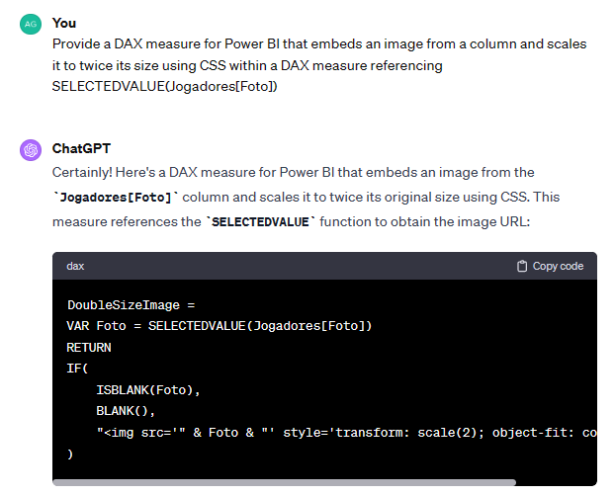
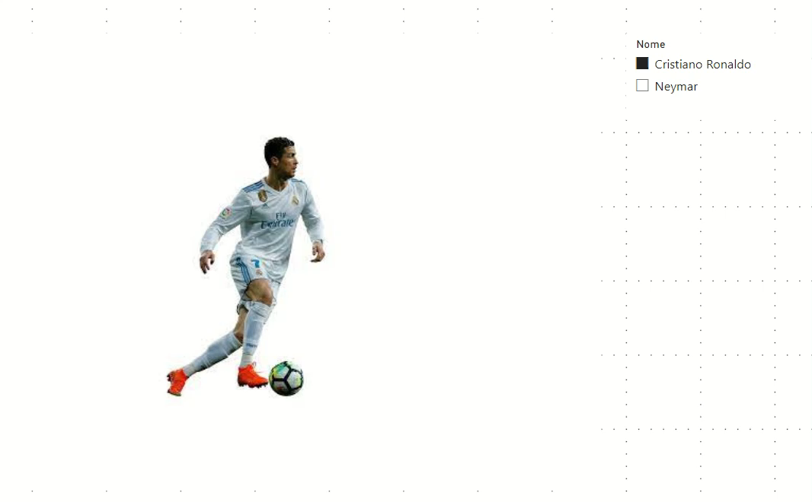

Generate DAX CSS Measure
HTML Custom Visual

Slide 10
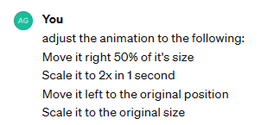
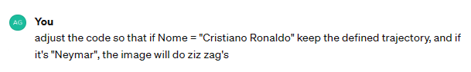
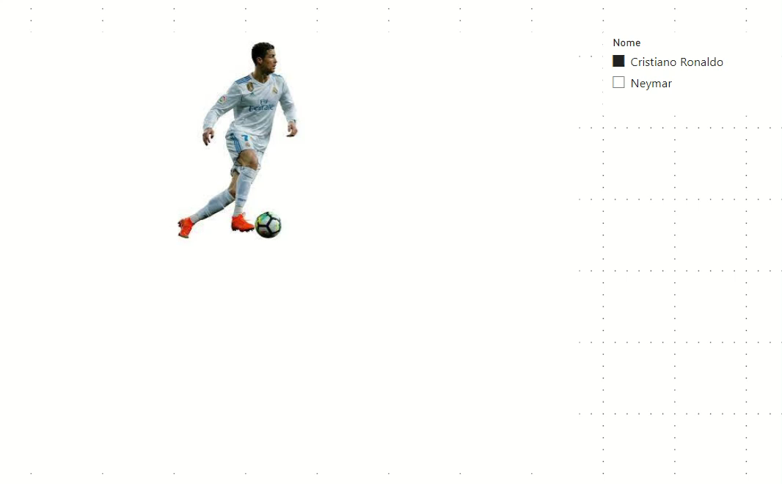
Generate DAX CSS Measure

Slide 11

2) Data Modeling & Analysis
Analyze a Data Model
Analyze Data
Generate a Data Model

Slide 12
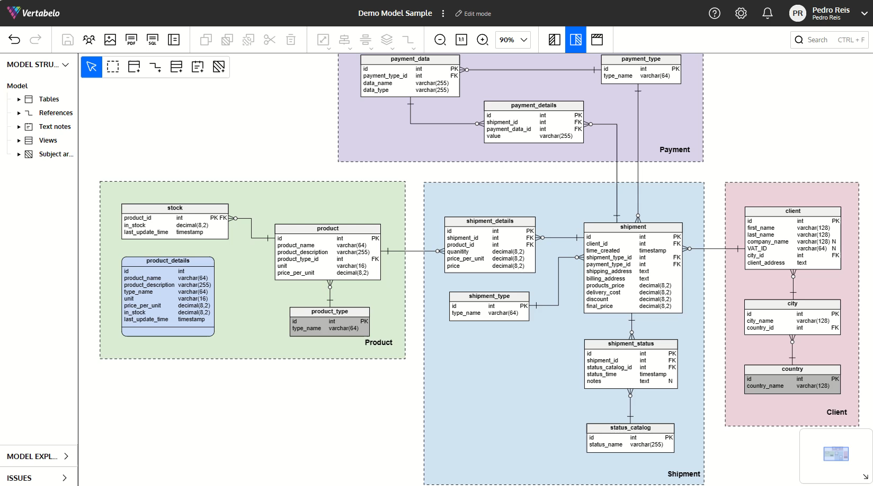

Slide 13
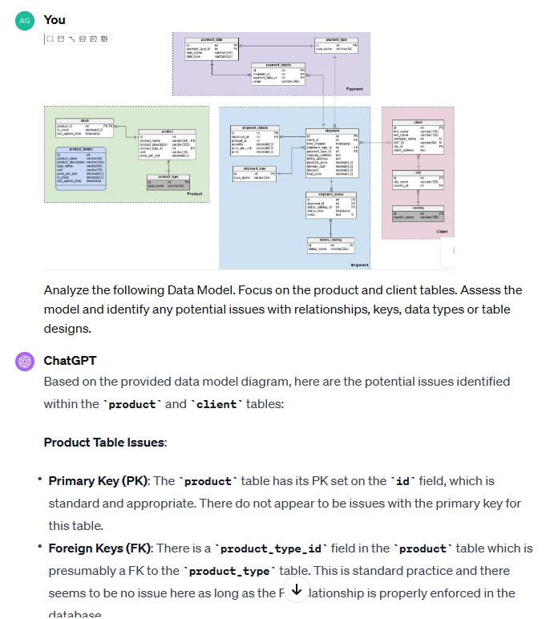
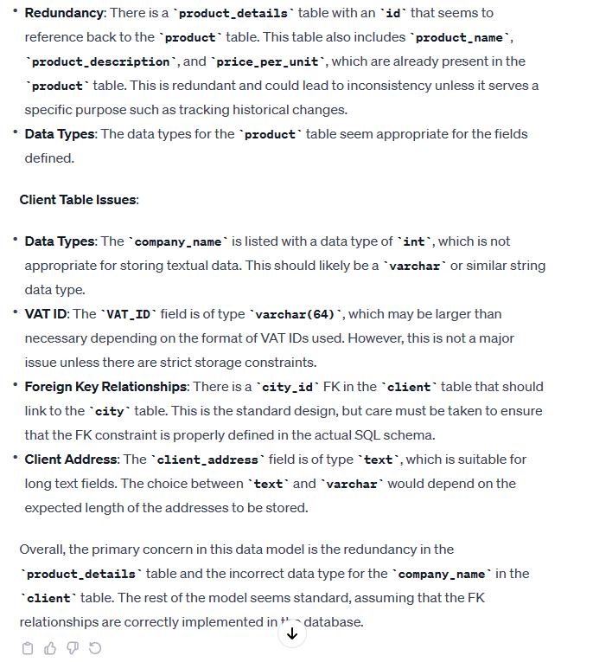
Data Model Analysis

Slide 14
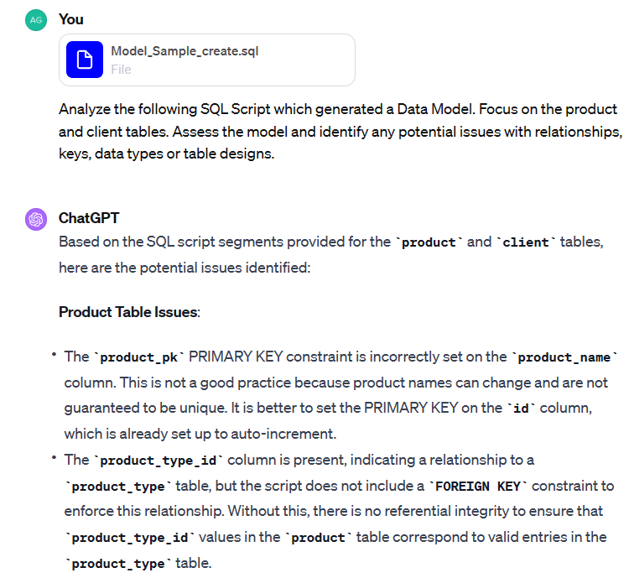
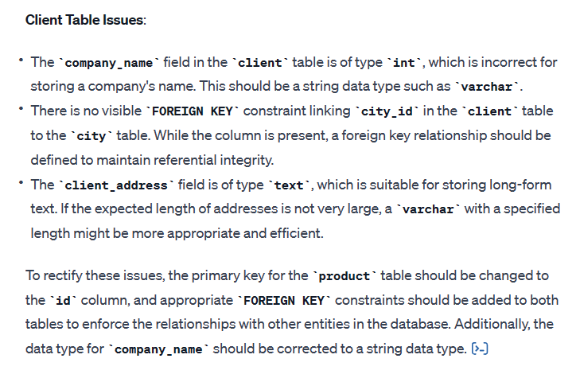
Data Model Analysis

Slide 15
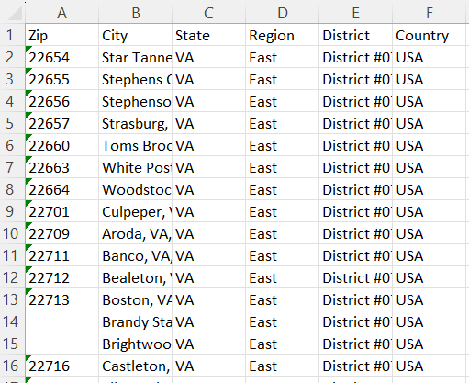
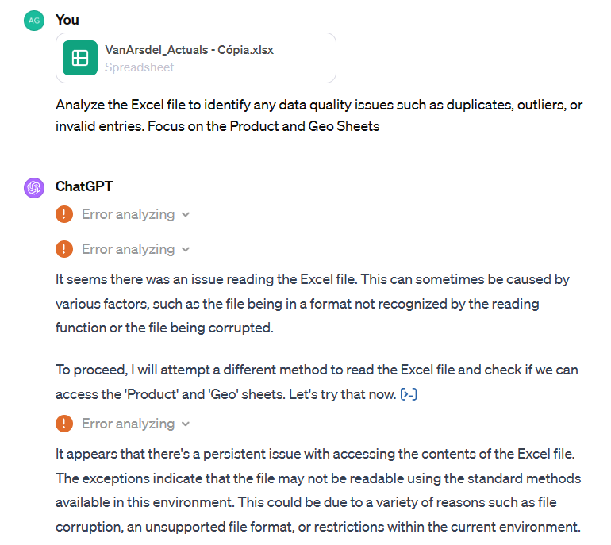
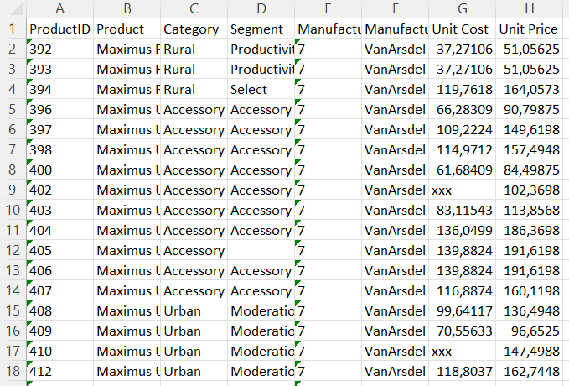
Data Quality

Slide 16
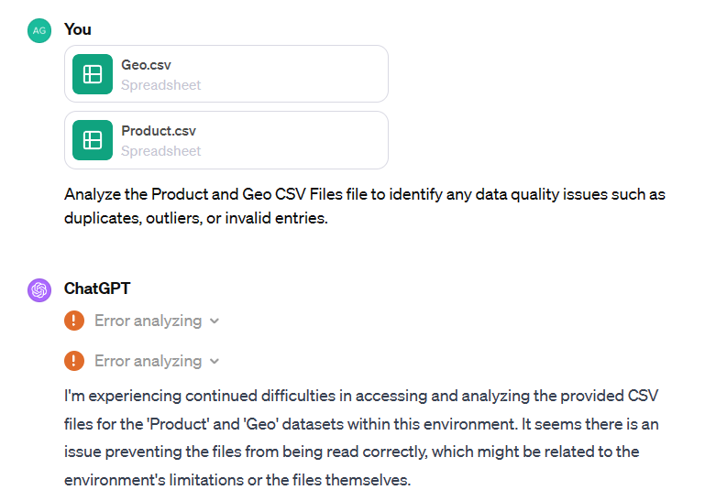
Data Quality

Slide 17
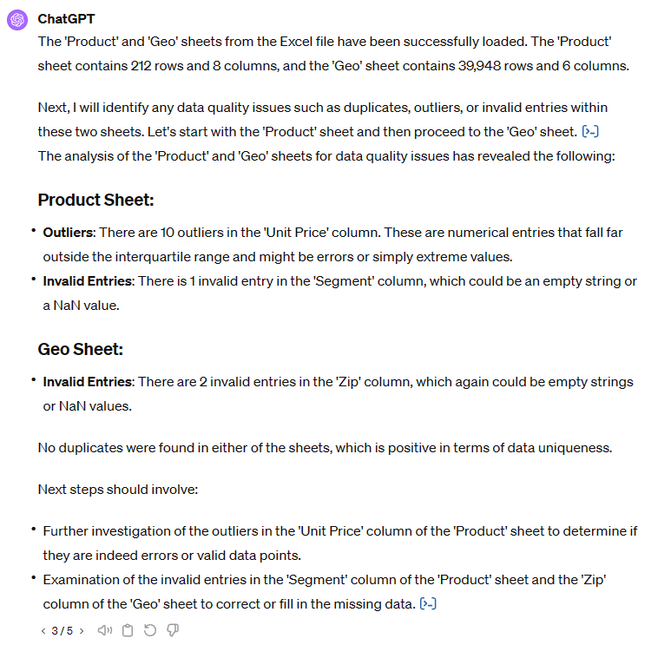
Data Quality

Slide 18

3) Report Design Assessment
Analyze report design
Rate report design
Provide recommendations

Slide 19
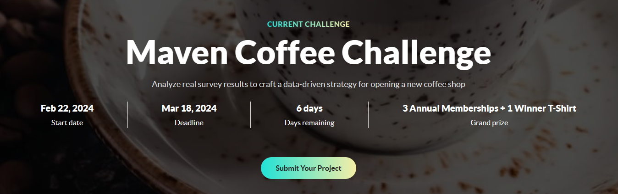
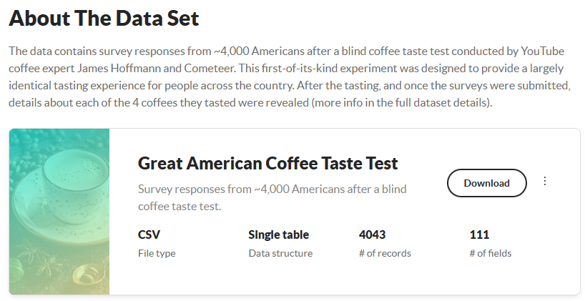
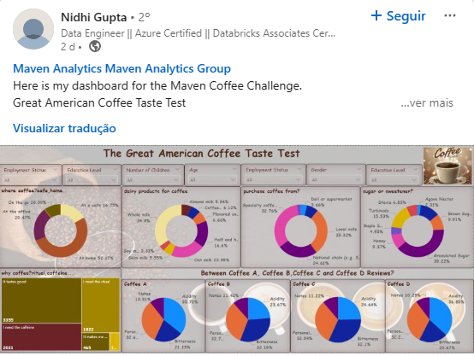
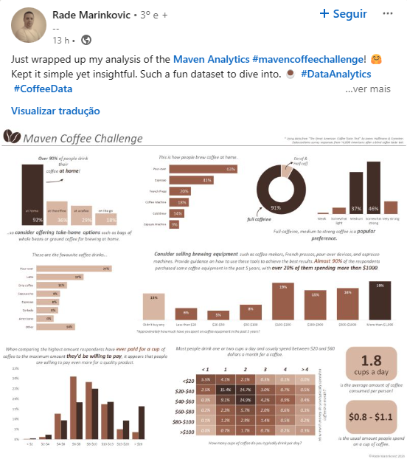
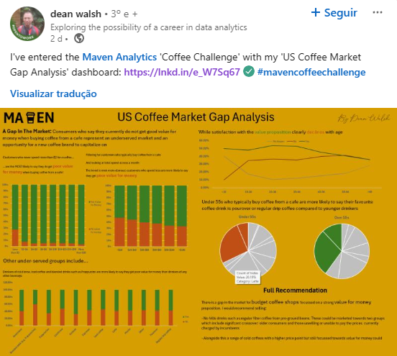
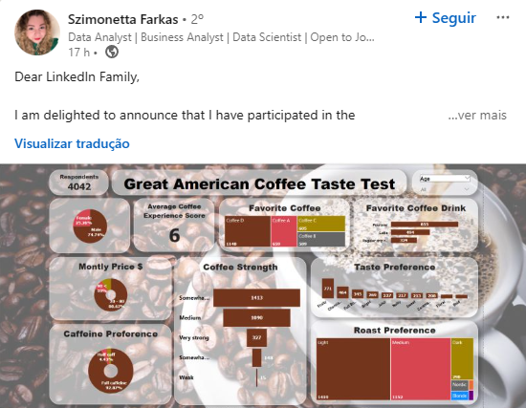

#mavencoffeechallenge

Slide 20
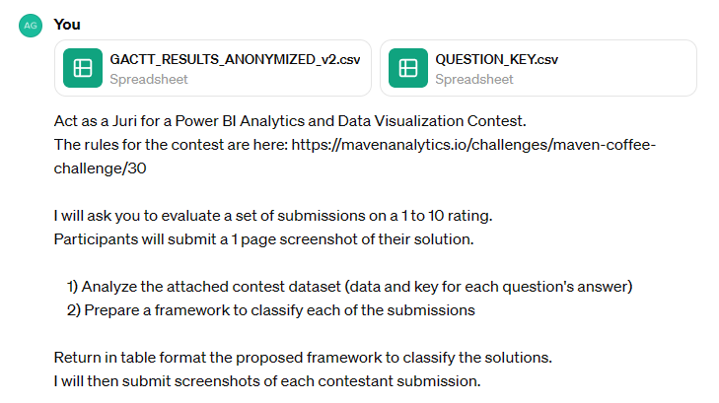
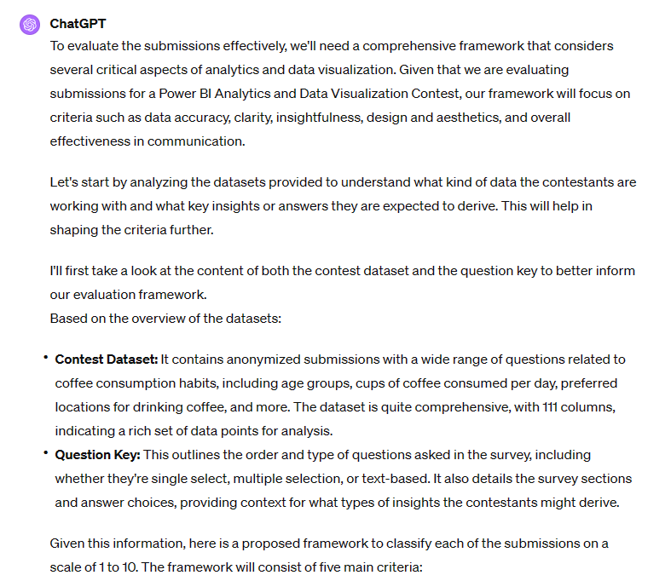

Slide 21
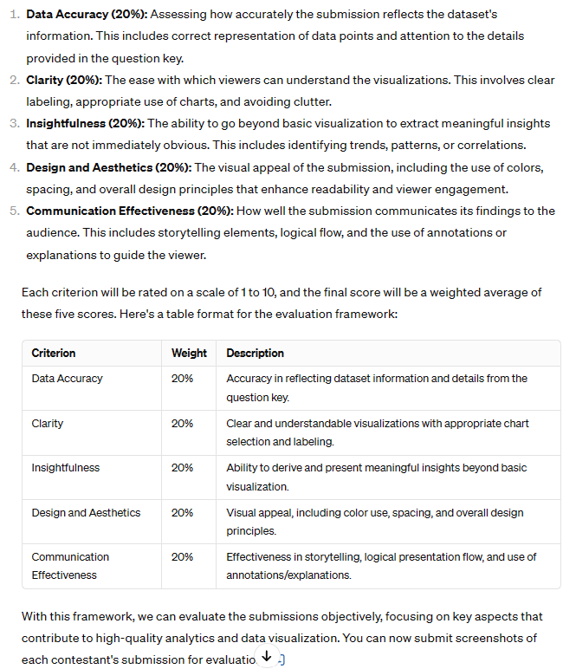
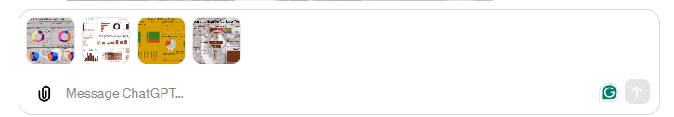
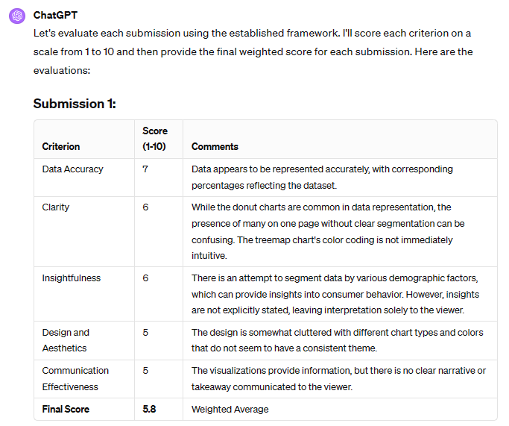

Slide 22
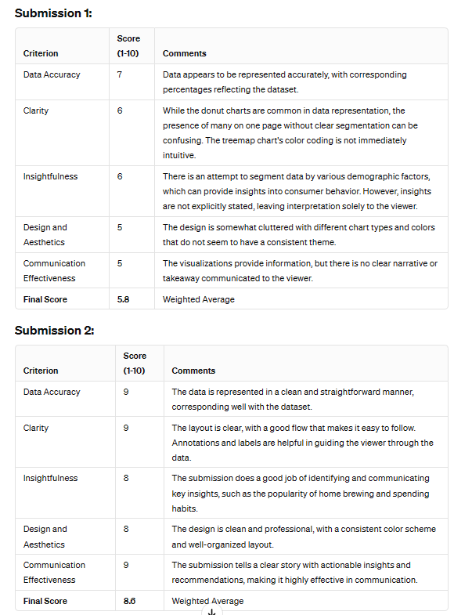
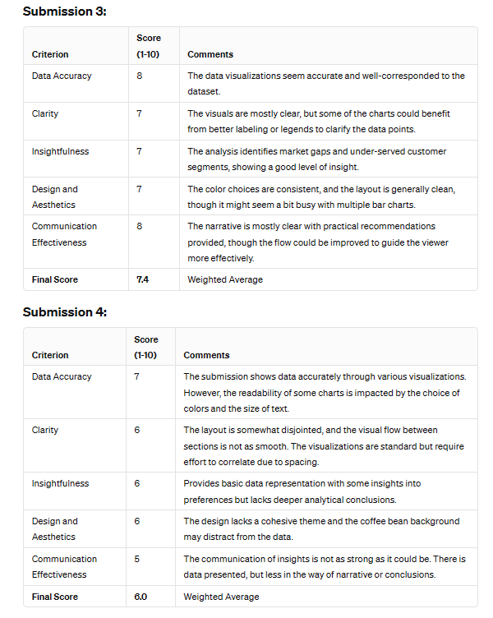

Slide 23

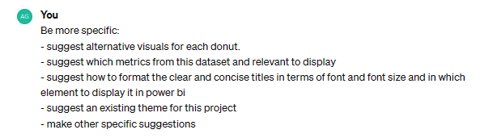
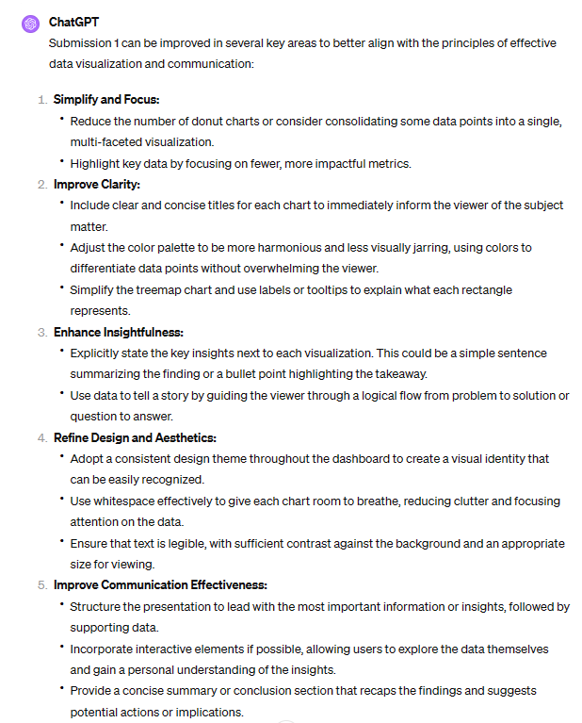

Slide 24
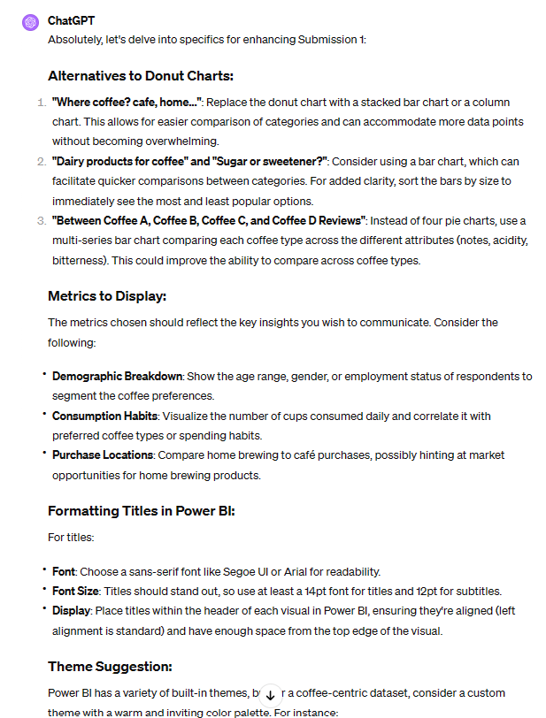
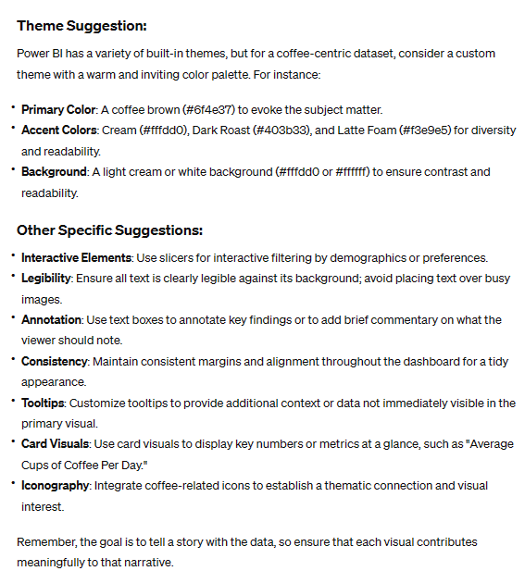

Slide 25

4) Troubleshooting
Troubleshooting Problem
Understanding errors
Performance Optimization

Slide 26
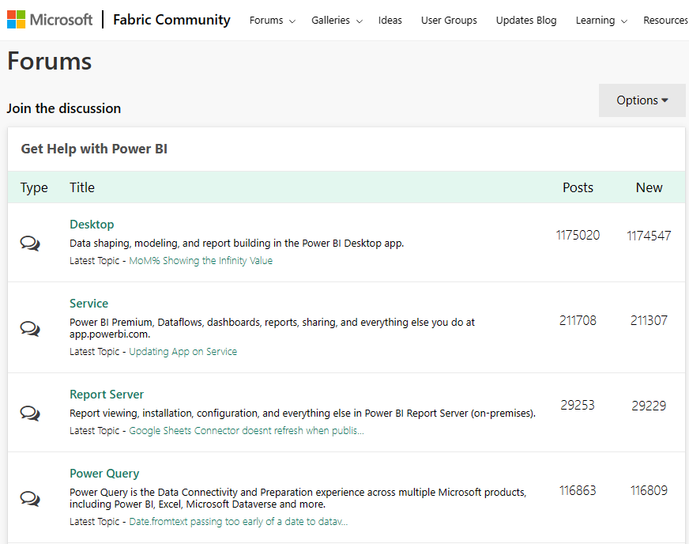

Slide 27
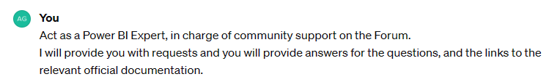
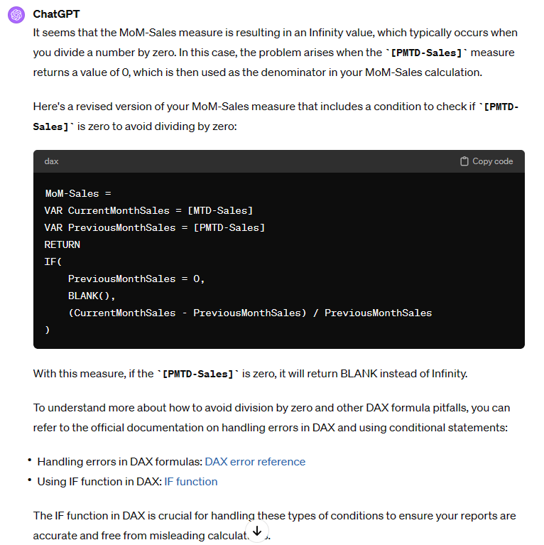
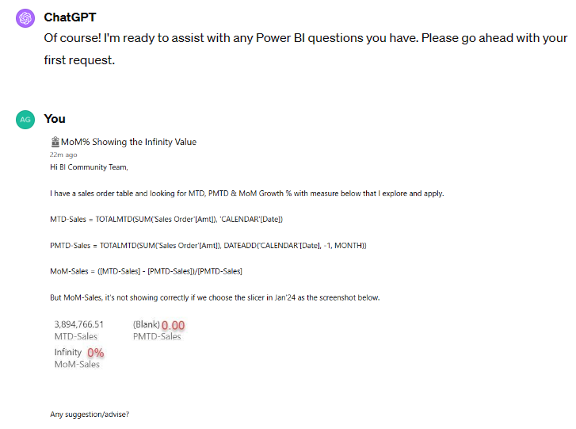

Slide 28
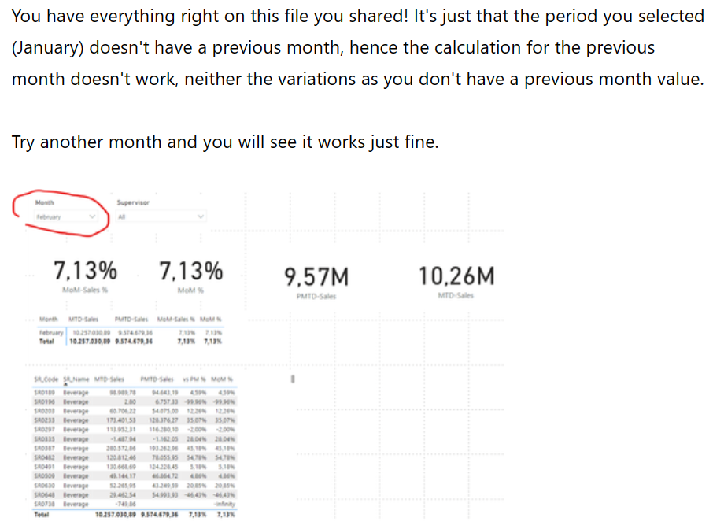

Slide 29
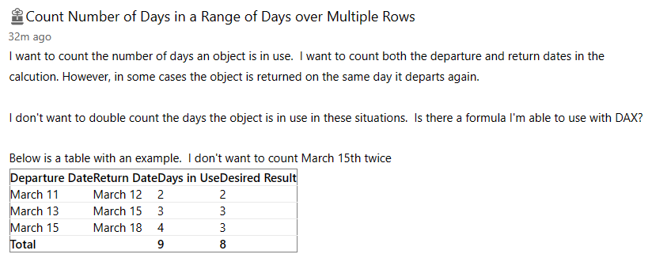
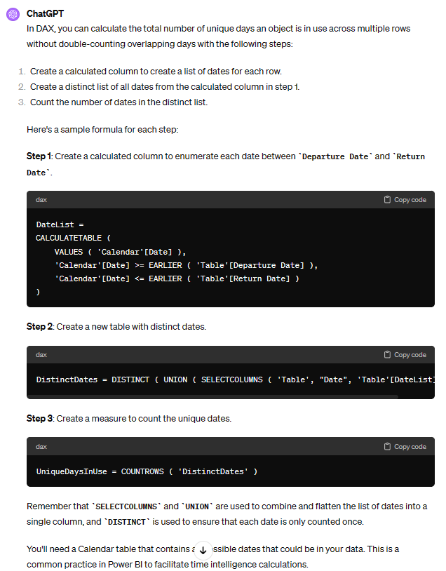

Slide 30
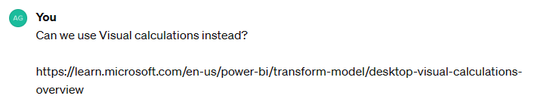
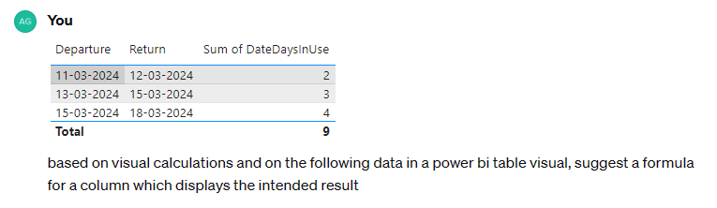



Slide 31


Slide 32



Slide 33

5) Knowledge
Knowledge Assessment
Knowledge Improvement

Slide 34



Knowledge Assessment

Slide 35


Knowledge Assessment

Slide 36



Knowledge Improvement

Slide 37
Tomorrow another session
Today’s 20 Session
DAX w/ SVG and CSS
Data Modeling & Analysis
Report Design Assessment
Troubleshooting
Knowledge Assessment and Improvement
Tomorrow’s 40m Deep Dive
Generate a Data Model
Generate Artificial Data
Generate Power Query code
Generate DAX Measures
Enhance Report Theme
Publication & Administration w/ Cmdlets
Key Takeaways / The Future

Slide 38



Feedback
Let’s connect!
https://sqlb.it/?12520
pedroreis@reispm.onmicrosoft.com

Slide 39















